Slide 1
Task 11 - Forces and Vehicle Safety
Shelbee brown

Slide 2
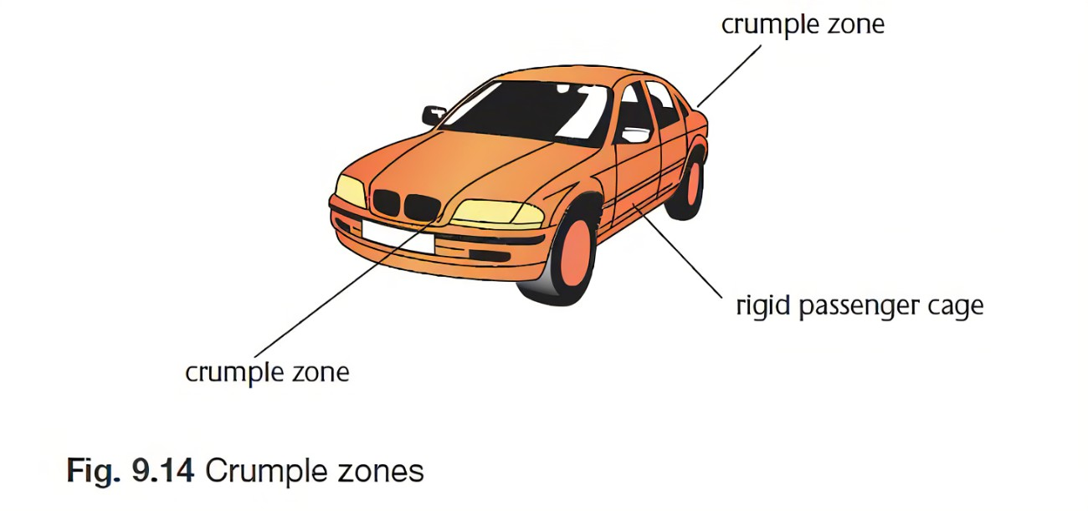
Increasing the time of the collision or the time the occupants take to stop
Crumple zones are an essential component of any transportation construction because they are used to absorb kinetic energy during collisions. There will thus be fewer fatalities among the cabin's occupants. Crumple zones perform a similar purpose to the cardboard boxes used in movie stunts to arrest a fall. As he descends, the stuntman produces kinetic energy, which, if he were to land on solid ground, would be immediately absorbed by his body, possibly with devastating consequences. Instead of hurting the stuntman, a well-planned stunt will ensure that the stuntman lands on a stack of boxes, causing the boxes to collapse. In a manner similar to this, crumple zones on automobiles are designed to lessen the amount of crash energy that is sent to the occupants following a collision with a solid object. Force is equal to mass times acceleration, states Newton's Second Law of Motion. In other words, if acceleration and force are proportionate, then the force will be half as strong when the acceleration is cut in half. Therefore, crumple zones are designed to reduce the rate of a vehicle's deceleration, which in turn reduces the force imparted to the vehicle. Crumple zones collapse in a manner that reduces the magnitude of deceleration, which also prolongs the time it takes for an automobile to come to a complete stop.

Slide 3
Spreading the forces of impact over the largest possible area & ensuring stability of the vehicle.
The front of the automobile can collapse like an accordion thanks to crumple zones, which helps to absorb some of the shock and let it out as heat and noise. Effectively acting as a cushion, the front of the automobile lessens the energy that must be applied to the occupants at a complete stop, possibly sparing their lives. The intention is to steer the force created by an impact away from the occupants. At the time of the accident, everyone inside the car uses some of the force, as does everything that happens to it. Think about the amount of force necessary to bend the steel frame of an automobile. Since it is employed to bend the frame, this amount of force never affects the passengers. Crumple zones are founded on this notion. Many vehicle parts are built using special interior structures that were created to resist tearing, crushing, crumpling, and breaking. The fundamental tenet is that it takes force to injure them. The same amount of force is used in crumple zones.
Mass times acceleration equals force. The slowdown cuts the force in half. Therefore, increasing the deceleration interval from.2 seconds to.8 seconds will result in a reduction in total force of 75%. Crumple zones accomplish this by creating a buffer zone around the exterior of the vehicle. One example of a part that is rigid and resistant to deforming by nature is the passenger compartment and engine of a vehicle. If those rigid parts come into contact with something, they will decelerate quickly and violently. Less rigid materials can endure the initial hit thanks to crumple zones surrounding those components. The car slows down and extends the deceleration by a few extra tenths of a second after the crumple zone starts to crumble.
A lowered suspension will increase your car's stability during curves and emergency manoeuvres. improved aerodynamics When an automobile is lowered, less air is moving beneath it, which could reduce the drag on the vehicle.

Slide 4
Minimizing contact of the person with the interior of the vehicle
Front airbags have been required for all new cars since 1998, and for light trucks since 1999. The majority of autos had them even before that. Crash sensors connected to an onboard computer detect a frontal collision and trigger the airbags. In the blink of an eye, the bags enlarge before starting to deflate. Although airbags have saved many lives, they may hurt or even kill children or other passengers who are not buckled up. Children under the age of 12 should always travel in the back in the appropriate restraint system, and rear-facing child seats should never be installed in front seats with airbags. Airbags protect the areas of your head, neck, and chest. Within seconds of the collision, they burst from the dashboard or the steering wheel. The airbag progressively deflates after colliding with the driver, enabling the driver to safely exit the car without becoming stuck. Once the speed exceeds 200–300 mph, the airbags in some cars will deploy. A collision sensor recognises when the car collides and signals the control module to deploy the airbag. The majority of these sensors are minute accelerometers, which are capable of precisely detecting the impact's deceleration. The air bags won't deploy unless the impact is severe enough to do so. In the event of a collision, a person who is not restrained will continue to go forwards at the same speed as the car until anything stops them. This could be the steering wheel, dashboard, or windscreen. In some collisions, the person might break a window and be thrown out of the vehicle in whole or in part, putting them in danger elsewhere. They might collide with stationary objects, be run over by their own or another car, or suffer a crushing injury. Even if the car has an airbag, the force with which an unrestrained occupant strikes the airbag could cause catastrophic injury.

Slide 5
Minimizing contact of the person with the interior of the vehicle
Seat belts keep you from moving around within the car in the event of an accident. When they sense a collision, the seat belts lock into place. Newton's First Law states that when an automobile crashes, the person is not subject to an unbalanced force, hence they continue to go forwards. The person pushes on the seat belt, exerting stress on it. The seat belt's force is then applied to the person (Newton's Third Law). A person's controlled deceleration is the outcome of this. In the event of an accident, seat belts prevent you from tossing around within the vehicle. The seat belts lock into position when they detect a collision. Because there is no uneven force exerted on the individual when the car crashes, they go ahead. (The First Law of Newton). A force is applied to the seat belt as the individual moves against it. The person is then subjected to force from the seat belt (Newton's Third Law). This results in a person's controlled deceleration.

Slide 6
Keeping the person inside the vehicle
The Newton's Second Law, which states that greater forces produce greater acceleration while greater masses provide less acceleration, is relevant to seat belts. The obvious benefit of a seat belt is that it keeps you from accelerating. If you were in a car accident and were struck hard, you might want to accelerate more quickly, but the seat belt would stop you. Have you ever heard the rumour that a tissue box placed on the back dashboard of a car will cause it to abruptly stop? From the back dashboard, the tissue box shot forwards and towards the front of the car, where it could have pierced someone's brain. The car would have needed to be moving at a faster pace for the force of the tissue box to punch a hole in someone's head. The force of the car stopping led the tissue box to fly forwards since the car was moving more quickly as it came to a stop, which is related to Newton's Second Law and seat belts. You will accelerate forwards and crash into whatever is in front of you if you are not wearing a seat belt, whether you are in the front or back seat. So, belt up at all times, regardless of your age. Oh, and if I were you, I wouldn't leave a tissue box on your rear dashboard. A car drives with inertia, which is an object's propensity to move up until an external force acts to stop it. That inertia varies when the vehicle strikes something or is struck by anything.

Slide 7
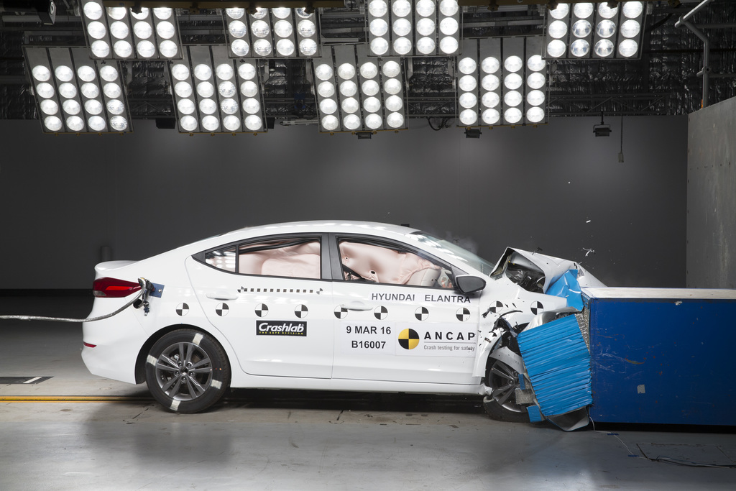
Hyundai i30
Safety feature
Lane Following Assist: When used, it keeps the vehicle centred in its lane on motorways and city streets at speeds between 0 and 180 km/h.
Forward Collision-Avoidance Assist: Using radar and a camera to monitor the road ahead, the FCA system immediately applies the brakes when it notices an oncoming vehicle braking suddenly, as well as oncoming bicycles and pedestrians. Utilizing two radar sensors in the lower rear bumper, the blind spot collision-avoidance assist system alerts you to vehicles in your blind spot. If you use the turn signal in this circumstance, it will sound an audible alert and brake to avoid a collision. When reversing out of low-visibility regions, the system not only alerts the driver if vehicles are approaching from the side but also automatically applies the brakes. Rear Cross-traffic Collision-avoidance Assist Lane Keeping Assist can apply counter steering power to help the vehicle return to its lane after alerting the driver of an unintentional lane departure. Intelligent Speed Limit Warning: This feature recognises speed limit and no-passing signs on the road and displays them in real-time in the instrument cluster and navigation system display. Driver Attention Warning: The system alerts you and pops up a message recommending a break when it detects a trend of driver weariness or distraction.

Slide 8
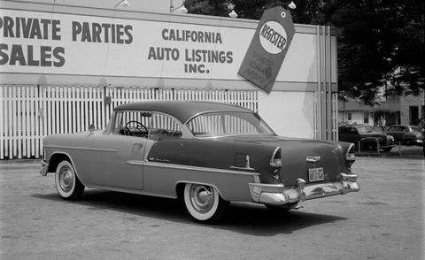
1955 Chevrolet – how are they unsafe?
A-Pillars: The windshield of the 1955 was a stunning wraparound. Additionally, it left the front of the roof supported by just a few flimsy sheet metal pillars, ready to give way under the weight of the vehicle in the event of a rollover. Simply observe them, though. Injuries to the forehead or sternum are all but guaranteed by the bullet-nose cap at the hub of the two and three-spoke steering wheels of Chevy vehicles.
Dash: These aren't any soft, squishy places. Metal that could crush skulls was only softened by paint. As pedestrians were thrown into the air, the hood ornament's jagged edges served as a spectacular ode to jet-age style. Lever for the parking brake is made of a merciless steel rod and a merciless steel tube. Also known as the Damocles Sword.
Door latches: In a crash, if they didn't automatically open, they remained closed due to obstructions from crumpled buildings.
Doors: no soft surfaces, no built-in guard beams, and handles and window cranks that seem to be made to sever flesh. This combination of doors and a buckling structure results in an animal trap. It's astonishing that we survived at all.
Front Crumple Zone: There was no controlled energy absorption upon a collision, only buckling of the frame and passenger compartment and metal folding onto itself. You would be stuck within if a horrifying wound didn't kill you when the doors couldn't be opened.
Front Bench Seat: The front seats were only held in place by a few bolts, and since there were no seatbelts to keep occupants in place in the event of a crash, a body would have continued to bounce around the cockpit like a pinball.

Slide 9
Summarise the role safety in a car design
Roadways in the future will be safer because to the advancements in vehicle technology over the past few decades. Safety systems are now available that can deal with a variety of potentially dangerous situations, such as poor sight, sloppy road conditions, unintended lane departure, and risky lateral swerving. Additionally, in an effort to reduce injuries to passengers in cars during collisions, safety system designers continually improving existing airbag and seat belt systems, adding new whiplash prevention, and head protection technologies. Furthermore, because so many safety measures work well together, they are typically packaged and offered in thoughtful combinations. As a result, each safety feature can enhance overall vehicle safety beyond what it can do alone.
For instance, drivers using adaptive headlights may see potential road hazards sooner than they would without them. If adaptive headlights and brake assistance are used simultaneously, drivers are better able to recognise risks sooner and are more likely to be able to stop in time to avoid an accident. Electronic stability control (ESC) and anti-lock brake systems (ABS) collaborate in similar ways.
Every year, millions more individuals get behind the wheel, and the more people there are, the more likely it is that a crash will occur. In order to combat this, newer vehicles ought to be equipped with as many safety systems as are practical, helping to lessen damage and lower the likelihood of collisions in the first place.

Slide 10
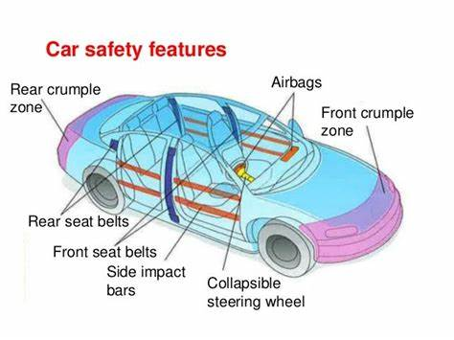
Suggest improvements using principles of physics
There are numerous design changes that can be performed to make automobiles safer. Installing modern disc brakes would greatly enhance the control and stopping power of a vintage or antique car. Your vintage or classic car may still have its original drum brakes, which provide powerful stopping power but require periodic adjustments due to wear and tear. Make sure the three-point seatbelts in your car are up to date and securely attached. Airbags: Crumple zones: Body of the vehicle: sensors and radar

